Slide 1
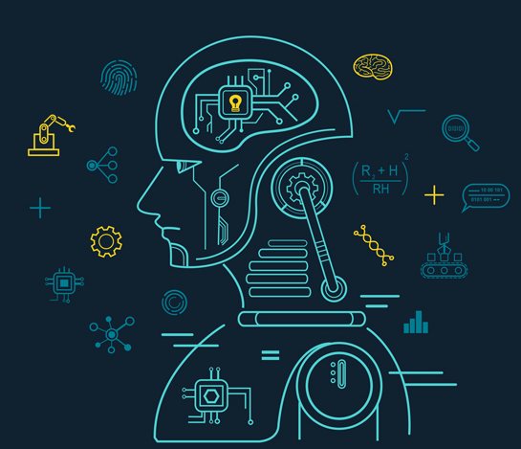
MACHINE LEARNING
-Mounika Voriganti

Slide 2
What Is Machine Learning
Form of AI that enables a system to learn from data rather than through explicit programming.
Can be explained as automating and improving the learning process of computers based on their experiences without being actually programmed i.e. without any human assistance.

Slide 3
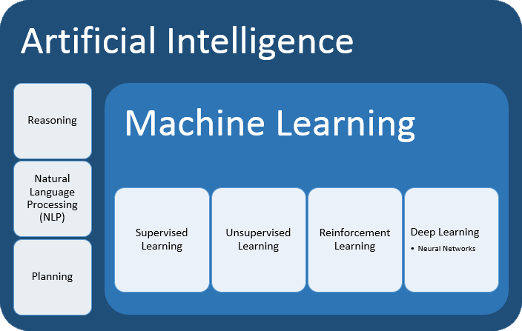

Slide 4
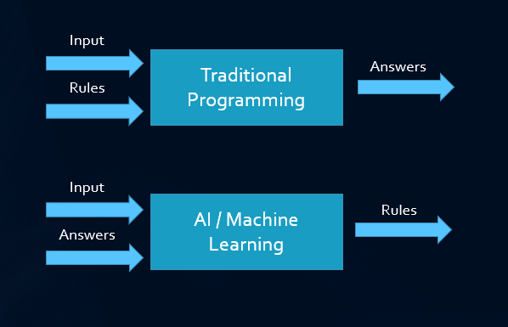
Traditional programming & Machine Learning
Traditional Programming: We feed in DATA (Input) + PROGRAM (logic), run it on machine and get output.
Machine Learning: We feed in DATA(Input) + Output, run it on machine during training and the machine creates its own program(logic), which can be evaluated while testing.

Slide 5
Uses Of Python
Offers concise and readable code.
While complex algorithms and versatile workflows stand behind machine learning and AI, Python's simplicity allows developers to write reliable systems.
Code is understandable by humans, which makes it easier to build models for machine learning.
Some important libraries are Numpy, Pandas, Scikit learn.

Slide 6
Real Time Example
ML in Healthcare Industry
Helps in predicting Chronic diseases.
Ensures shorter LOS (Length of Stay) for the patients.
Helps in preventing Hospital-acquired Infections (HAI).
Applications:
Medical Imaging Diagnosis
Identification of disease and DIagnosis of the same
A clinical trial, research for incurable diseases

Slide 7
Companies that use Machine Learning
Yelp: Image curation
Pinterest: Improved content discovery
Uber: Route-based pricing system
Facebook: Chatbot Army

Slide 8
Thank You

